Slide 1
Day 10 CI / CD Part 2

Slide 2
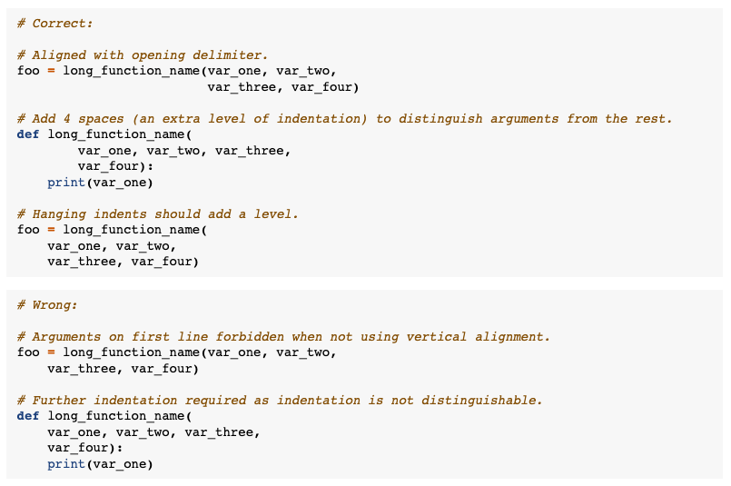
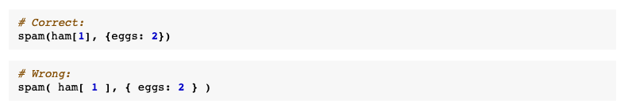
Code Styling
Code styling is team-dependent
(Python Enhancement Proposal) PEP 8 is commonly used
Screenshots from https://peps.python.org/pep-0008/

Slide 3
Linting
Linting: check code for errors (both programmatic and style)
There are many linters to choose from: pylint, flake8, pycodestyle, and others
Use linters within your IDE (pycharm, VSCode)
Configure with a pyproject.toml file
pyproject.toml
[tool.pylint.messages_control]
disable = [
"missing-final-newline",
"missing-function-docstring”,
. . .
]
pip install pylint
pylint file.py

Slide 4
Code Formatting
Formatters: will format your code for you
isort – sorts your imports
Autopep8 – PEP 8 auto-formatting
Black – opinionated formatter
pyproject.toml
[tool.pylint.messages_control]
disable = [
"missing-final-newline",
"missing-function-docstring”,
. . .
]
[tool.black]
line-length = 100
target-version = ['py39']
skip-string-normalization = true
[tool.isort]
length_sort = true
pip install black isort
black file.py
isort file.py

Slide 5
Deployment

Slide 6
Deployment
everything to turn an artifact into a maintainable system

Slide 7


Deployment Types
Online
Has to happen now
Offline
Occurs in intervals

Slide 8
Online Deployment
Client
Gimme info
API
Here you go

Slide 9
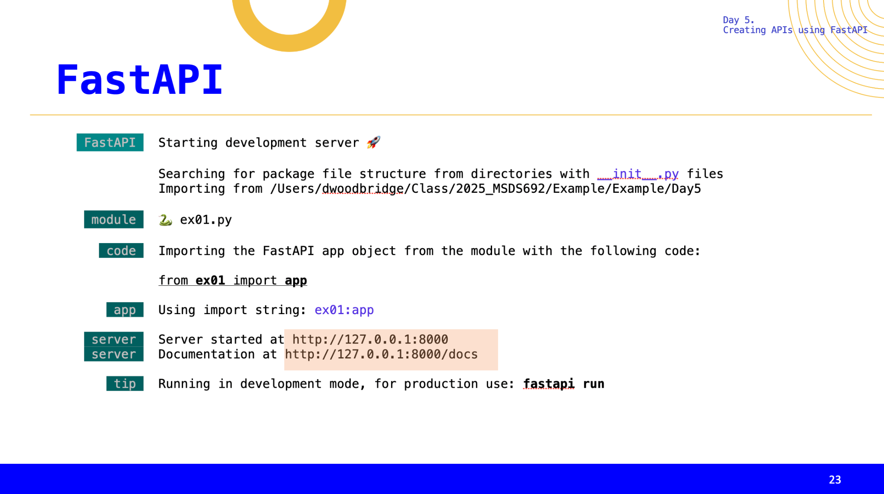

Slide 10
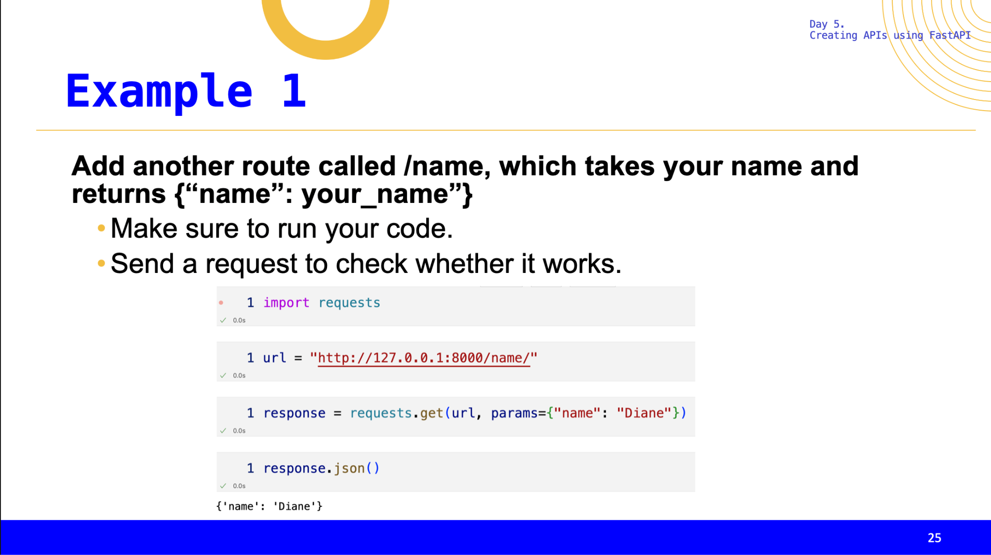

Slide 11
Continuous Deployment

Slide 12
Definition
Automatically update and serve model

Slide 13
Seems dangerous, right?
There is another CD, continuous delivery, which automates all steps except the push to production

Slide 14
How?
GitHub Actions, CRON, etc.

Slide 15
Example
Each N (hour/day/week/month), we:
1. Pull data
2. Train challenger and champion model
3. Evaluate models
4. Deploy the model that wins

Slide 16
Example Pseudo Code
def load()
Load or pull updated data
def train()
Champion and Challenger model
def evaluate()
Evaluate which model is better
def deploy()
Automatically deploy the better model
YAML

Slide 17
New model? New deployment methods
A/B Testing
Canary Deployment
Shadow Deployment

Slide 18

Canary Deployment
Subset of data tested with new model
Increase subset until original becomes subset
V1.0
(100-n)%
n%
V1.1

Slide 19
Canary Deployment
V1.0
90%
10%
V1.1

Slide 20
Canary Deployment
V1.0
80%
20%
V1.1

Slide 21
If Failure, then Rollback
V1.0
Rollback to previous version
V1.1

Slide 22
Shadow Deployment
Run new version of model on all data
V1.0
100%
100%
V1.1

Slide 23
Blue-Green Deployment
2 live production servers exist but only 1 is active at a time
Build out new features in 2nd server
V1.0
100%
0%
V1.1

Slide 24
Blue-Green Deployment
Once second server has all new features, switch
V1.2
0%
100%
V1.1

Slide 25
Application-based release pattern
Modify app to expose / hide feature
Via a toggle; if bad remove toggle
Can combine with Canary method

Slide 26
What to Expect
Goal: to learn branching strategies, and the importance of code styling and quality.
How: in the lab we will explore the use of git branches along with common python libraries for checking code quality.

Slide 27
Code Versioning and Branching
We already know how to use git for version control
And Github as a central code repository (along with other nice features).
Branching is how you might collaborate with other team members on the same codebase, without stepping on each other’s toes
Many branching strategies, will be team-dependent.
Necessary when collaborating, not when working solo.

Slide 28
Branching
# script for doing stuff
test.py
main

Slide 29
Branching
# script for doing stuff
git commit –m ‘first commit’
test.py
main

Slide 30
Branching
# script for doing stuff
git checkout –b dev
test.py
main
dev

Slide 31
Branching
# script for doing stuff
test.py
main
dev
# script for doing stuff
import pandas as pd
test.py

Slide 32
Branching
# script for doing stuff
git commit –m ‘added library’
test.py
main
dev
# script for doing stuff
import pandas as pd
test.py

Slide 33
Branching
# script for doing stuff
# script for doing stuff
test.py
test.py
main
dev
# script for doing stuff
import pandas as pd
test.py

Slide 34
Branching
# script for doing stuff
# script for doing stuff
test.py
test.py
main
dev
# script for doing stuff
import pandas as pd
# script for doing stuff
import pandas as pd
import numpy as np
test.py
test.py

Slide 35
Branching
# script for doing stuff
# script for doing stuff
# script for doing stuff
test.py
test.py
test.py
main
dev
# script for doing stuff
import pandas as pd
# script for doing stuff
import pandas as pd
import numpy as np
test.py
test.py

Slide 36
Branching
# script for doing stuff
# script for doing stuff
# script for doing stuff
# script for doing stuff
import pandas as pd
import numpy as np
test.py
test.py
test.py
test.py
main
dev
Merge or pull request!!
# script for doing stuff
import pandas as pd
# script for doing stuff
import pandas as pd
import numpy as np
git checkout main
git pull
git merge dev
git branch –d dev
test.py
test.py

Slide 37
Branching Strategies
main
main
main
dev
rel 1.0
Github Flow
Trunk-based Development
GitFlow

Slide 38
Branching Strategies
Feature branches off the main branch
You, as the DS, may work off of your own branch
Merge or use pull request to merge to main branch
Main branch is the “production” branch
Bug can be introduced into production code since there is no separate “development” or “release” branch
main
main
main
dev
rel 1.0
Github Flow
Trunk-based Development
GitFlow

Slide 39
Branching Strategies
No branches
Frequent pushes to main branch (trunk)
True CI/CD
Only for very experienced devs
main
main
main
dev
rel 1.0
Github Flow
Trunk-based Development
GitFlow

Slide 40
Branching Strategies
Consists of Main, Develop, Release, Feature, and Hotfix branches
Develop branches off of Main
Features branch off of develop
Releases are prepared and merged with develop and main
Complex, best for very large teams
main
main
main
dev
rel 1.0
Github Flow
Trunk-based Development
GitFlow

